Slide 1

Employee Transfer Management
Group 1 – C1212L
Group Member:
Duong Hoang Minh (Leader)
Luu Nguyen Van
Hoang Vu
Huy Nguyen Van
Instructor:
Mr. Cuong Nguyen Hung

Slide 2

Problem Definition
Manage huge data
No formal format for transfer records
Maintain
Report

Slide 3
Functional Requirements
Login
Transfer Management
Search
Update
Make new transfer
Employee can request transfer
Approval for request transfer
Generate allowances
Generate report
Logout

Slide 4
Goals of the System
System Administrator
Manage Transfers
Manage Employees
Manage Projects
Manage Departments and Locations
Manage Admin Account
Employee
View Basic Information
Generate Transfer Requests
View Transfer History

Slide 5

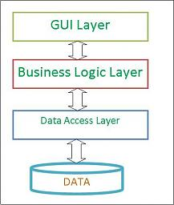
Technology

Slide 6
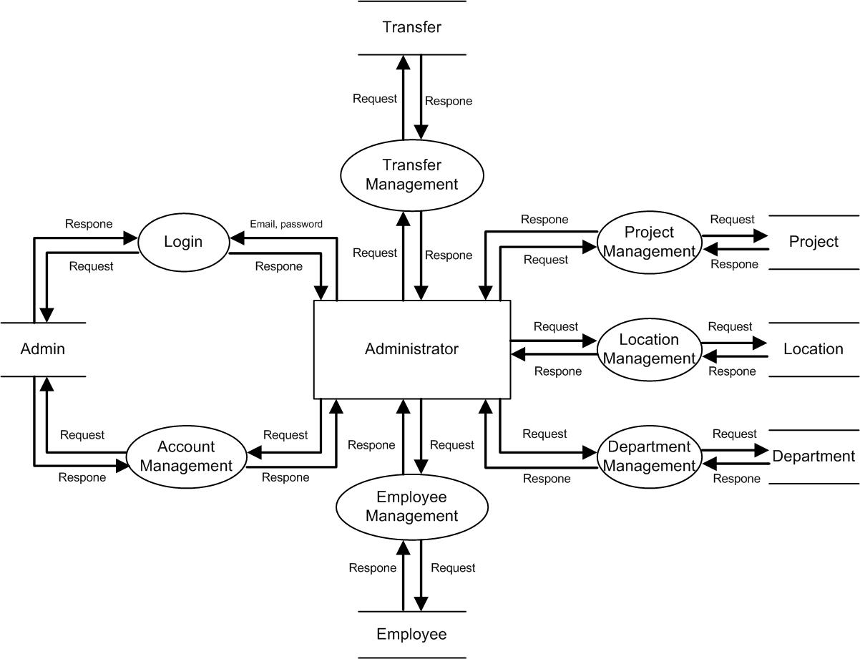
Data Flow Diagram

Slide 7
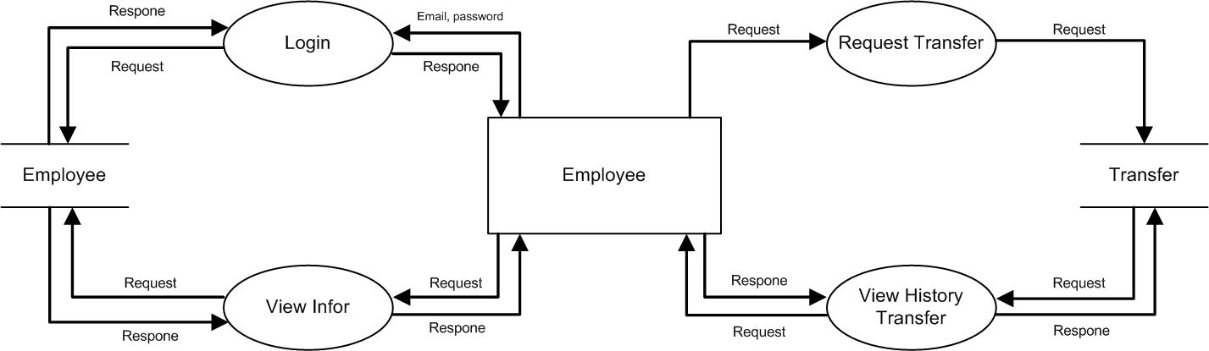
Data Flow Diagram

Slide 8
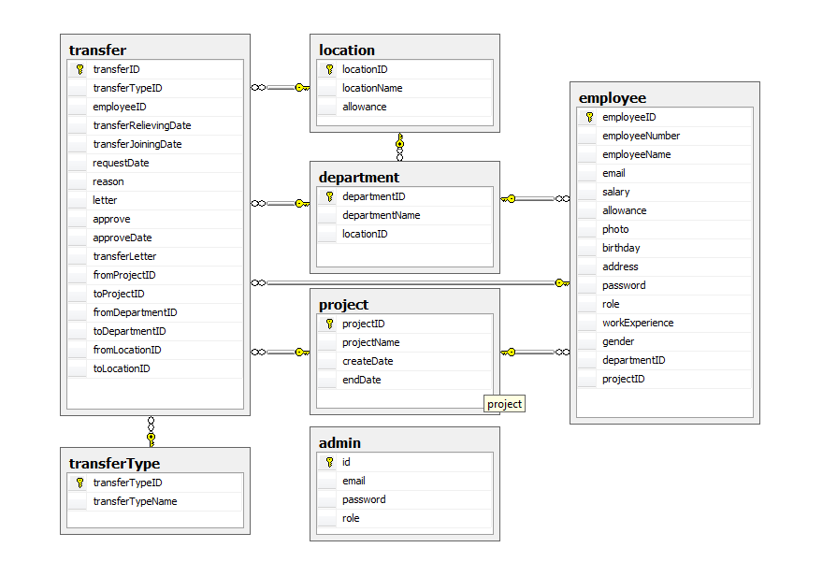
Database

Slide 9
Advantages and Remained Problems
Advantages
Satisfying requirements
Good UI
Remained Problems
Globalization
Optimal system and code

Slide 10
Demo

Slide 11
Acknowledgement
We are much thankful to the entire staff and chairmen at the Head Office of Aptech Worldwide, Aptech – Vietnam, and Bachkhoa – Aptech center who have been organizing and looking after our studying course.
Our special thanks to Mr. Nguyễn Hùng Cường who works day by day to teach and guide us in our travel to discover the wonder of Java Programming Language. Also to mentor in eProject Team at the Head Office who instruct and help us.

Slide 12
Thanks for your listening

